Slide 1
API-209
Class #1
Prof. Dan Levy | Harvard Kennedy School | Harvard University

Slide 2
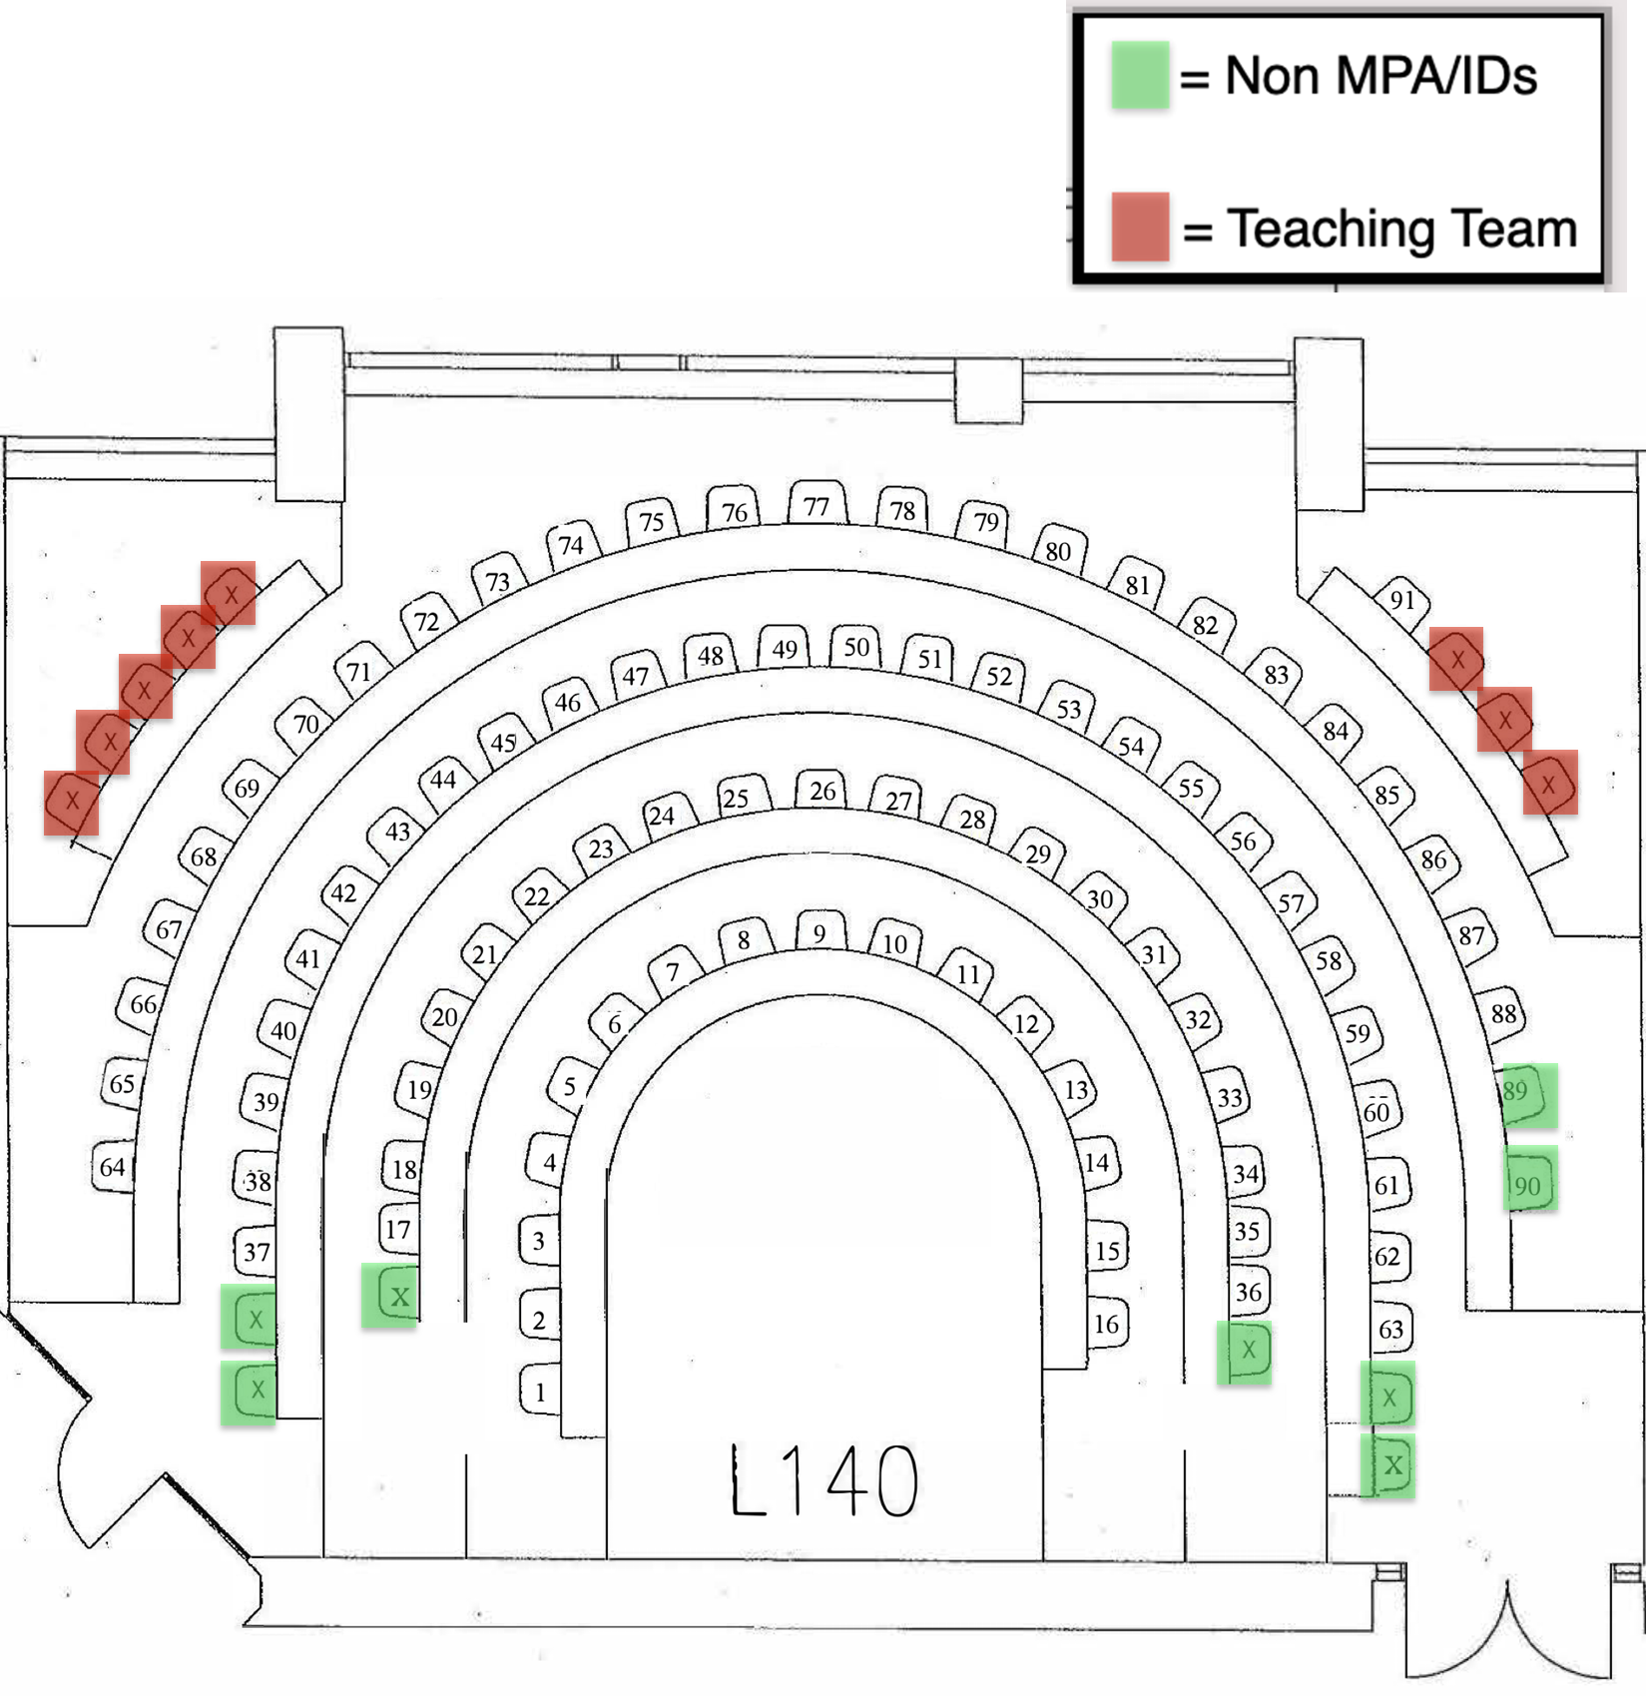

Slide 3
Welcome to API-209
Please pick up syllabus and handout #1 as you come in
Please sit as soon as possible
Please put your name card on your desk
Please go to www.pollev.com/danlevy and respond to question
Please put away your phone

Slide 4
Welcome to API-209
Please pick up syllabus and handout #1 as you come in
Please sit as soon as possible
Non-MPA/IDs: Please choose a seat in the back of the room
Please put your name card on your desk
Please go to www.pollev.com/danlevy and respond to question
Please put away your phone

Slide 5
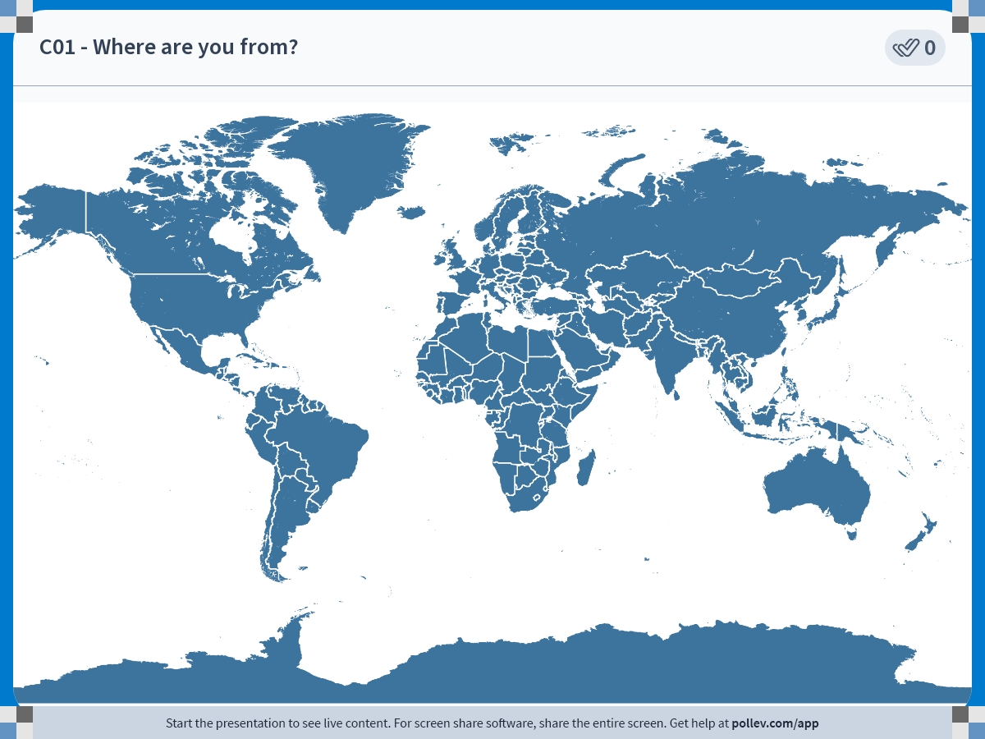
Notes:
Do not modify the notes in this section to avoid tampering with the Poll Everywhere activity.
More info at polleverywhere.com/support
C01 - Where are you from?
https://www.polleverywhere.com/clickable_images/weOF0yESNcy9xW0WTaFiZ

Slide 6
1 – Syllabus Overview

Slide 7



Pedagogic Approach
Notes:
.… it is pretty much grounded in Backward Design: When I design a course, I think of the 3-5 ideas that I would like my students to be able to master at the end of the course. The analogy I give the students from the beginning of the semester is that I want some concepts/ideas to be so deep in their bones that they can remember them 5 years from that moment when I see them at an airport. So the airport becomes a shorthand way of referring to concepts/ideas that are important.
The airport idea I would like to illustrate today is “Thinking Probabilistically about the world” which is one goal that we have for our students in the empirical methods courses I teach at the Kennedy School. The goal is not to transform them into statisticians but rather to change the way they view the world when it comes to uncertainty. I would normally have you read something before class, so the flow of this session might not be optimal. But my hope is that it will provide us with a common experience with which to have a productive debrief/reflection about teaching.
Alright, let’s begin. [think carefully about a transition here]
Image Credits (counterclockwise from left): (CC BY 2.0) – Nicola Delfino – flickr; (CC BY 2.0) Javier Pedreira – flickr; (CC BY 2.0) Nicola Delfino – flickr.

Slide 8
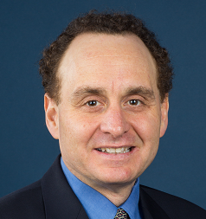



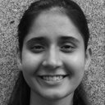
Our Teaching Team
Dan Levy
Faculty
Dom Valentino
Teaching Fellow
Victoria Barnum
Faculty Assistant
Angela Perez
Course Assistant
Callan Corcoran
Course Assistant
Shreya Dubey
Course Assistant

Slide 9
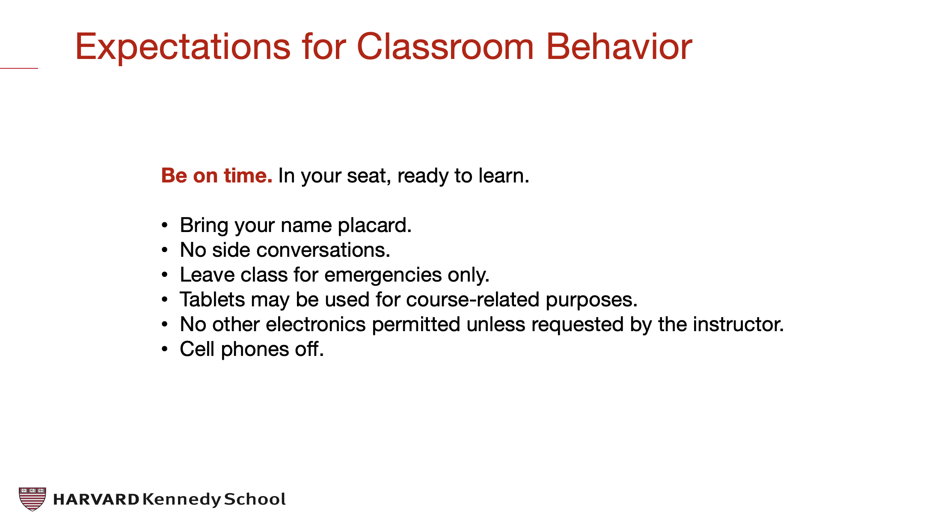
Expectations
Notes:
.… it is pretty much grounded in Backward Design: When I design a course, I think of the 3-5 ideas that I would like my students to be able to master at the end of the course. The analogy I give the students from the beginning of the semester is that I want some concepts/ideas to be so deep in their bones that they can remember them 5 years from that moment when I see them at an airport. So the airport becomes a shorthand way of referring to concepts/ideas that are important.
The airport idea I would like to illustrate today is “Thinking Probabilistically about the world” which is one goal that we have for our students in the empirical methods courses I teach at the Kennedy School. The goal is not to transform them into statisticians but rather to change the way they view the world when it comes to uncertainty. I would normally have you read something before class, so the flow of this session might not be optimal. But my hope is that it will provide us with a common experience with which to have a productive debrief/reflection about teaching.
Alright, let’s begin. [think carefully about a transition here]
Image Credits (counterclockwise from left): (CC BY 2.0) – Nicola Delfino – flickr; (CC BY 2.0) Javier Pedreira – flickr; (CC BY 2.0) Nicola Delfino – flickr.

Slide 10
Expectations
For every activity you undertake in this course, be:
Prepared
Punctual
Professional

Slide 11
Feedback
Nothing will be perfect
We are all here to learn
We are partners in learning

Slide 12
2 – The Big Picture

Slide 13

1 - Descriptive Use: Poverty in Peru

Slide 14

1 - Descriptive Use: Poverty in Peru
Sara Wong Becerra

Slide 15
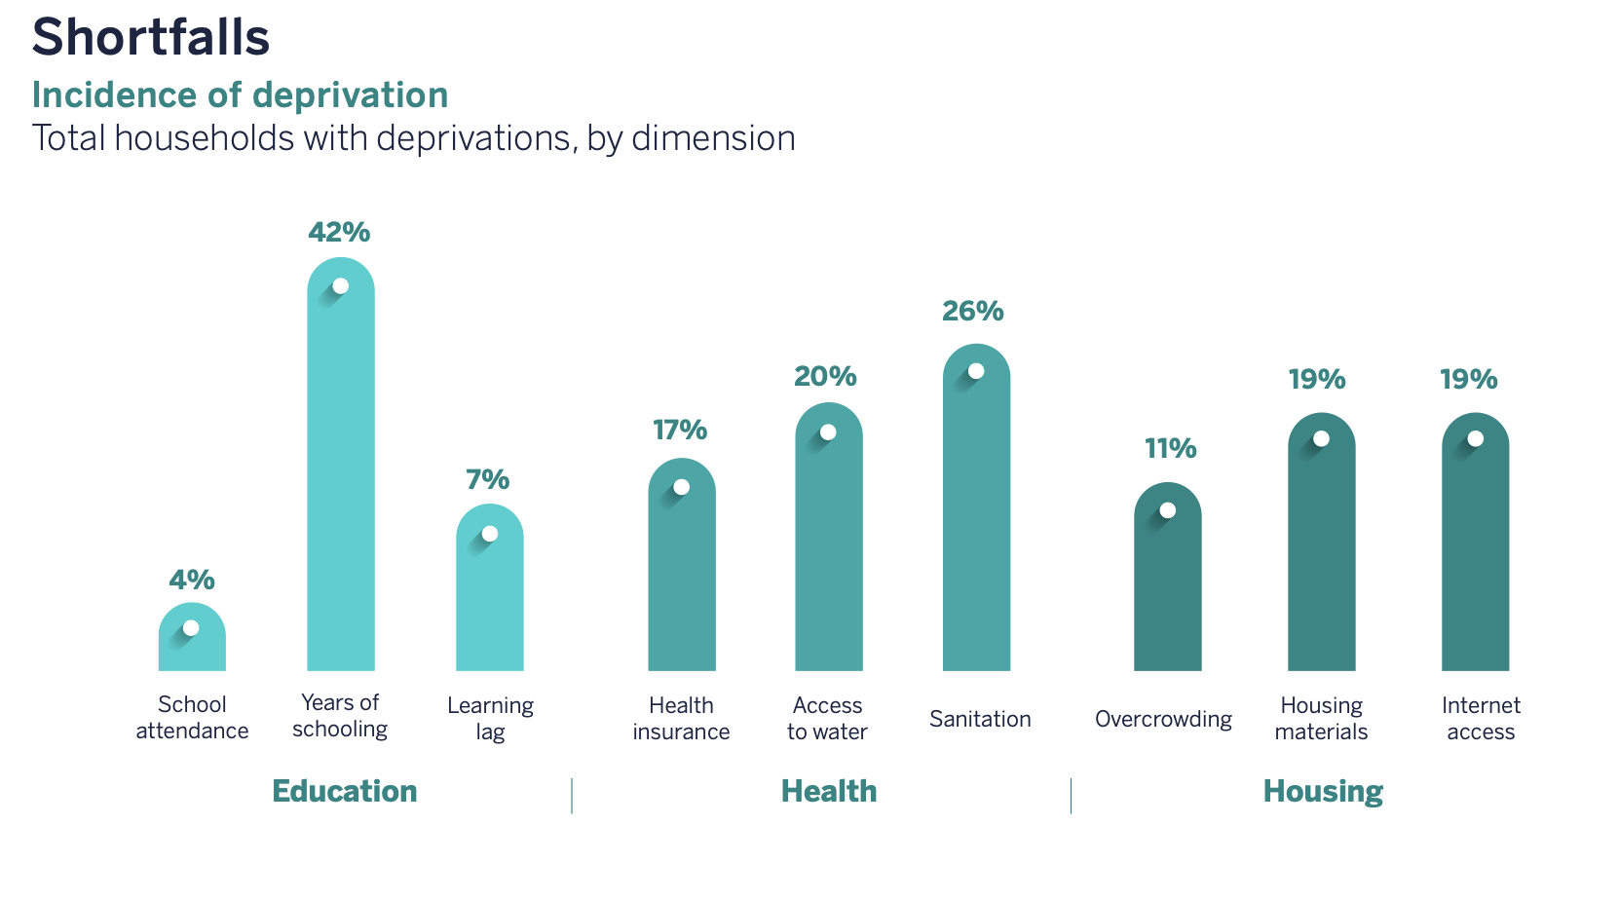
1 - Descriptive Use: Poverty in Peru
Sara Wong Becerra

Slide 16
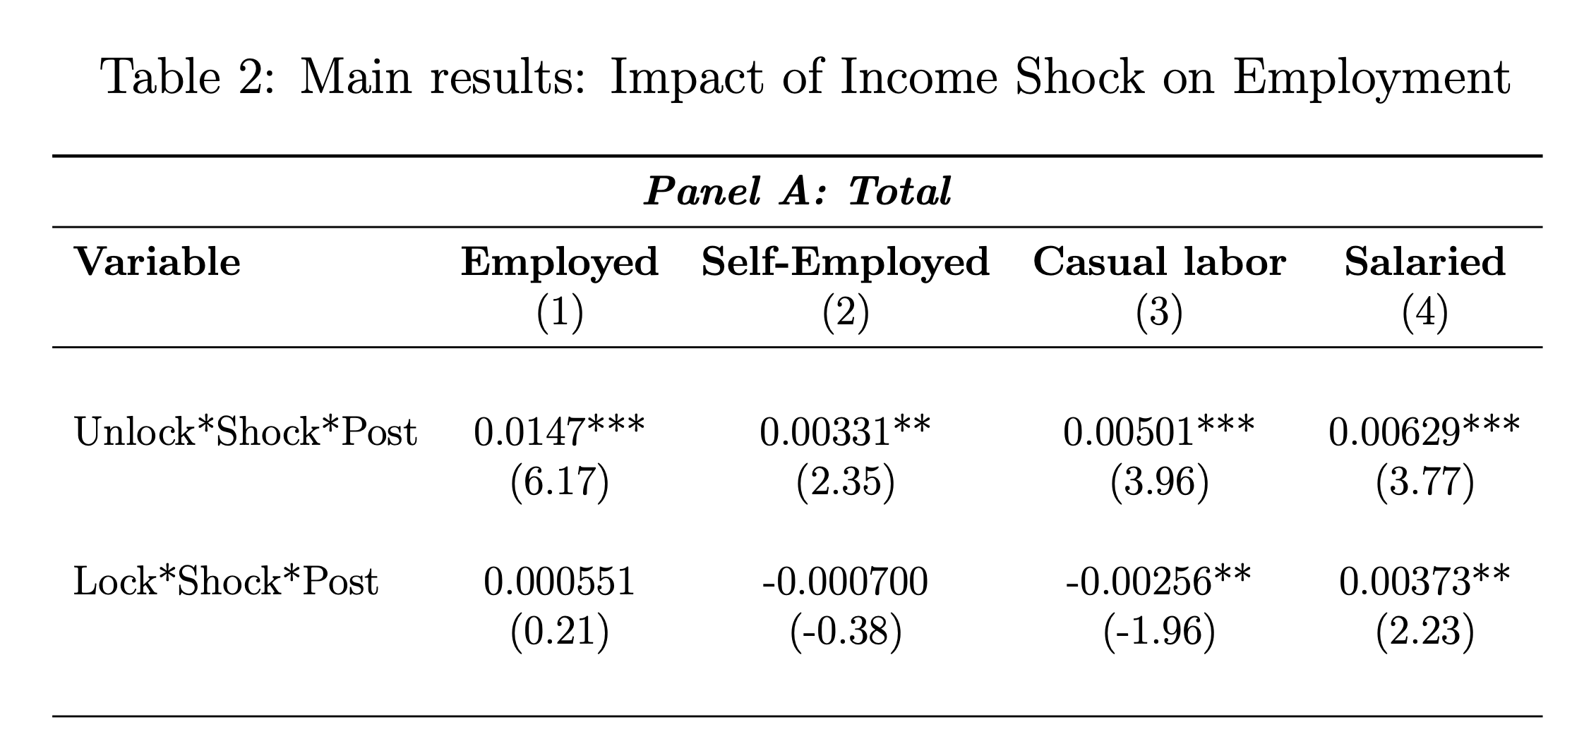

2 – Causal Use: Effect of income shocks in India
Ishaan Bansal
Notes:
Entre los principales resultados, se encuentra que los shocks de frío y de precipitación positiva favorecen la acumulación de capital humano, mientras que los de calor la reducen.

Slide 17

2 – Causal Use
Notes:
Entre los principales resultados, se encuentra que los shocks de frío y de precipitación positiva favorecen la acumulación de capital humano, mientras que los de calor la reducen.

Slide 18
2 – Causal Use
Ishaan Bansal
Notes:
Entre los principales resultados, se encuentra que los shocks de frío y de precipitación positiva favorecen la acumulación de capital humano, mientras que los de calor la reducen.

Slide 19
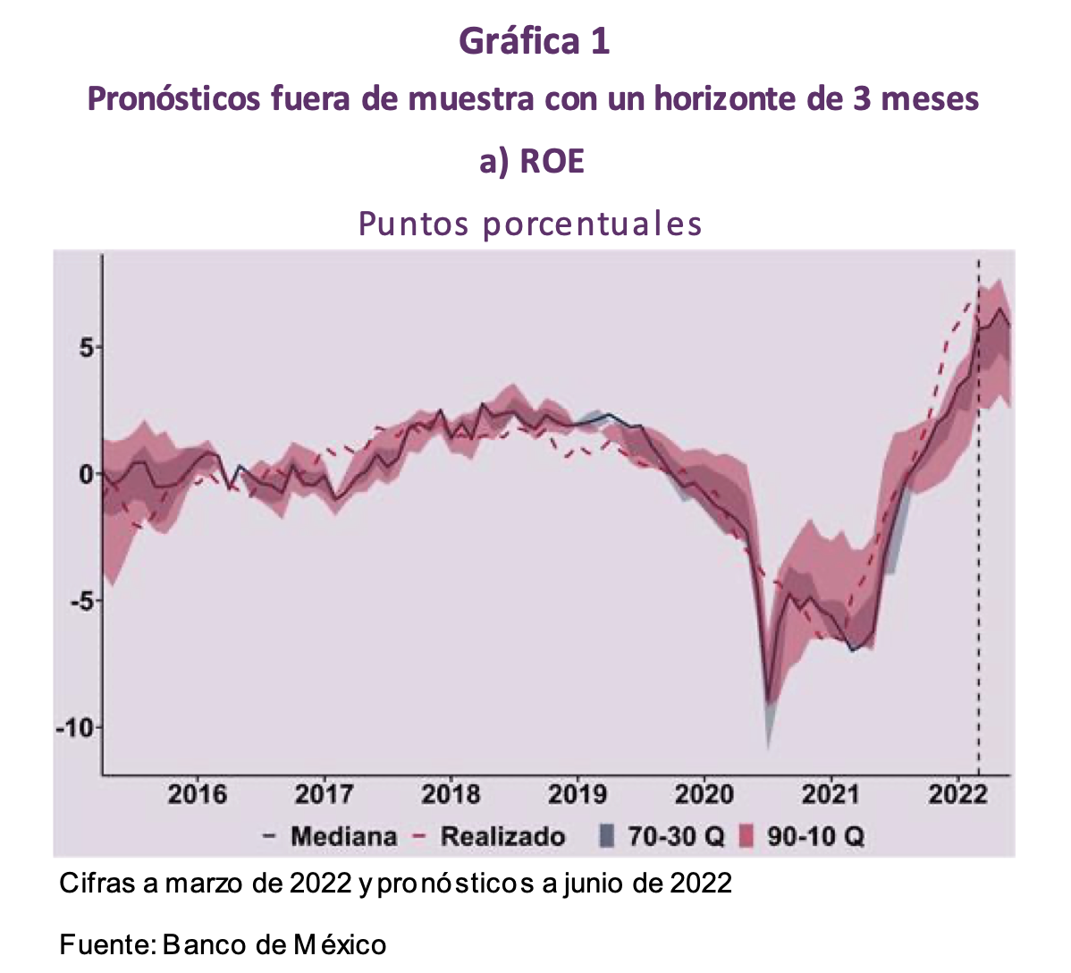
3 – Predictive Use: Banking indicators in Mexico
Notes:
Entre los principales resultados, se encuentra que los shocks de frío y de precipitación positiva favorecen la acumulación de capital humano, mientras que los de calor la reducen.

Slide 20

3 – Predictive Use: Banking indicators in Mexico
Alexa González
Notes:
Entre los principales resultados, se encuentra que los shocks de frío y de precipitación positiva favorecen la acumulación de capital humano, mientras que los de calor la reducen.

Slide 21
3 – Probability

Slide 22

Think about the 2016 U.S. Presidential Elections

Slide 23
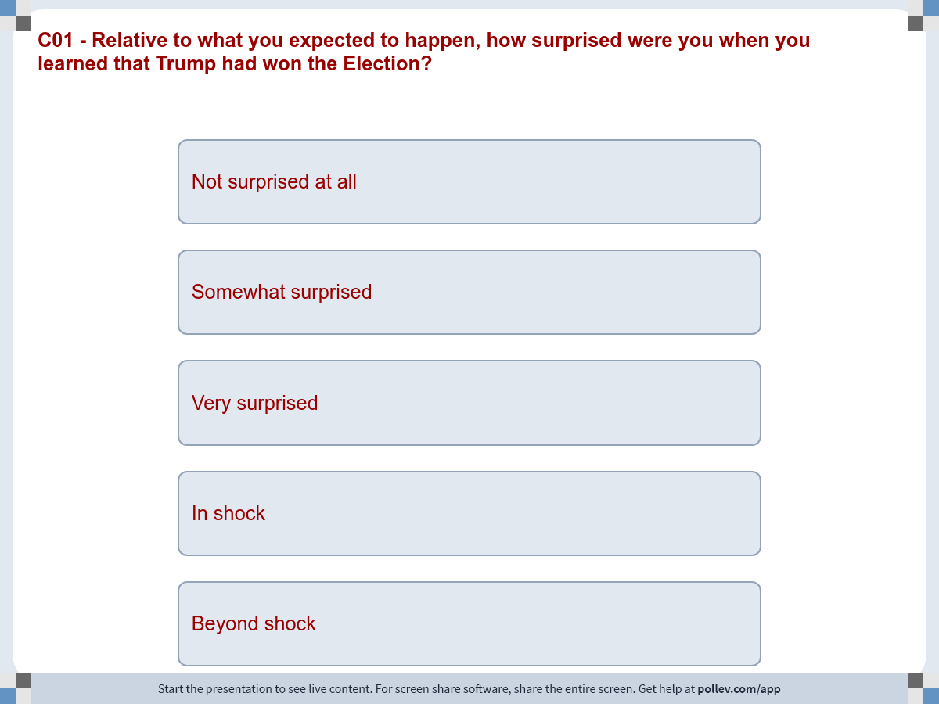
Notes:
Do not modify the notes in this section to avoid tampering with the Poll Everywhere activity.
More info at polleverywhere.com/support
C01 - Relative to what you expected to happen, how surprised were you when you learned that Trump had won the Election?
https://www.polleverywhere.com/multiple_choice_polls/BatGFJq9sOl863zOspGXr?display_state=instructions&activity_state=opened&state=opened&flow=Engagement&onscreen=persist

Slide 24
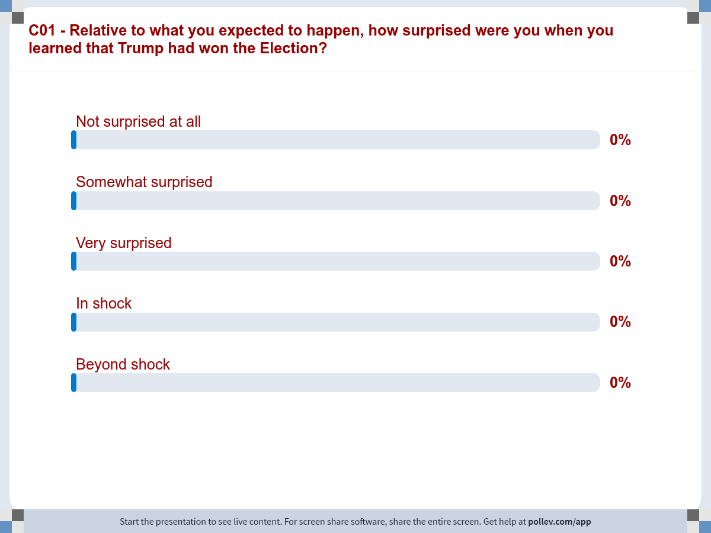
Notes:
Do not modify the notes in this section to avoid tampering with the Poll Everywhere activity.
More info at polleverywhere.com/support
C01 - Relative to what you expected to happen, how surprised were you when you learned that Trump had won the Election?
https://www.polleverywhere.com/multiple_choice_polls/BatGFJq9sOl863zOspGXr?display_state=chart&activity_state=opened&state=opened&flow=Engagement&onscreen=persist

Slide 25
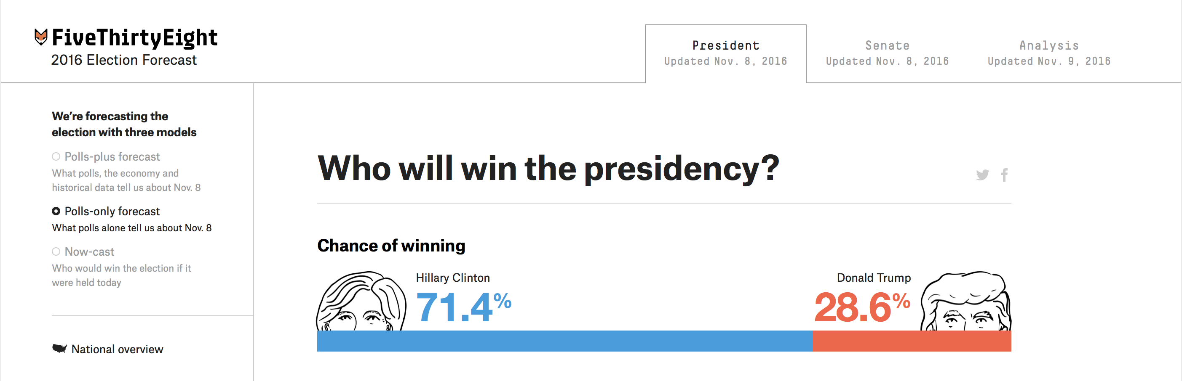
Why were we surprised?
Source: https://projects.fivethirtyeight.com/2016-election-forecast/

Slide 26

Shock "In 2016, I had a fervent belief that there would be no way that Donald Trump would get elected as President of USA. Looking back, I think I was definitely surrounded by an echo-chamber of like-minded friends with similar political views, so the night when I watched the election results, I remember being absolutely shocked that Hillary Clinton did not get elected."
Nidhi Rao

Slide 27
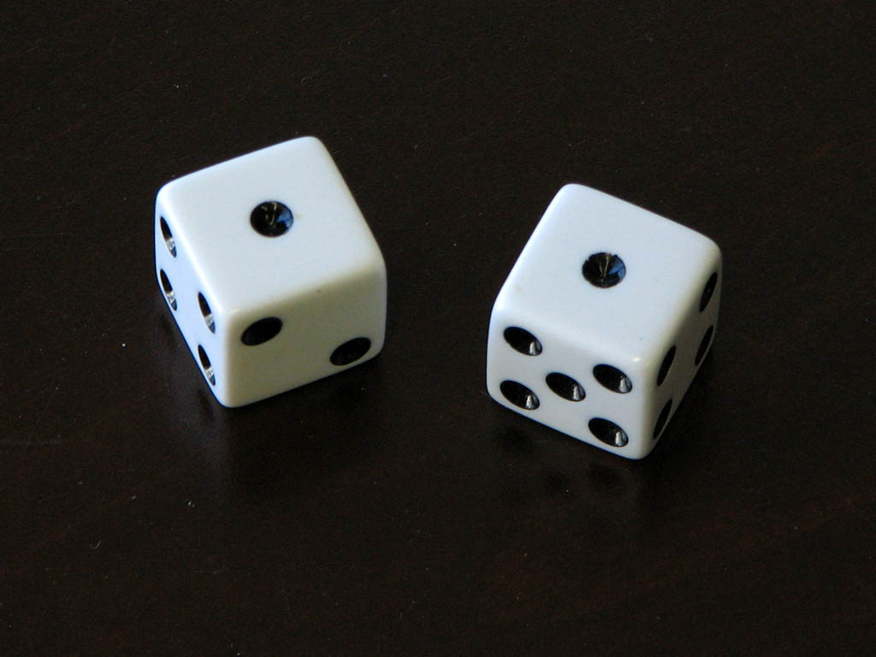
Thinking probabilistically about the world
Notes:
Wikimedia Commons: By Dennis Hill from The OC, So. Cal. - misc 24, CC BY 2.0, https://commons.wikimedia.org/w/index.php?curid=54704175

Slide 28
Principle #1 The world is much more uncertain than you think

Slide 29
Keys to Silver’s Prediction
Clinton’s coalition was poorly configured for the Electoral College.
Large fraction of voters went into the final week of the campaign undecided
Polls were fairly volatile in 2016 (especially in final stretch)

Slide 30
How 538 displays forecasts
2016
2020
Source: Fivethirtyeight. Accessed on Nov 8, 2016
Source: Fivethirtyeight. Accessed on Aug 31, 2020

Slide 31


Slide 32
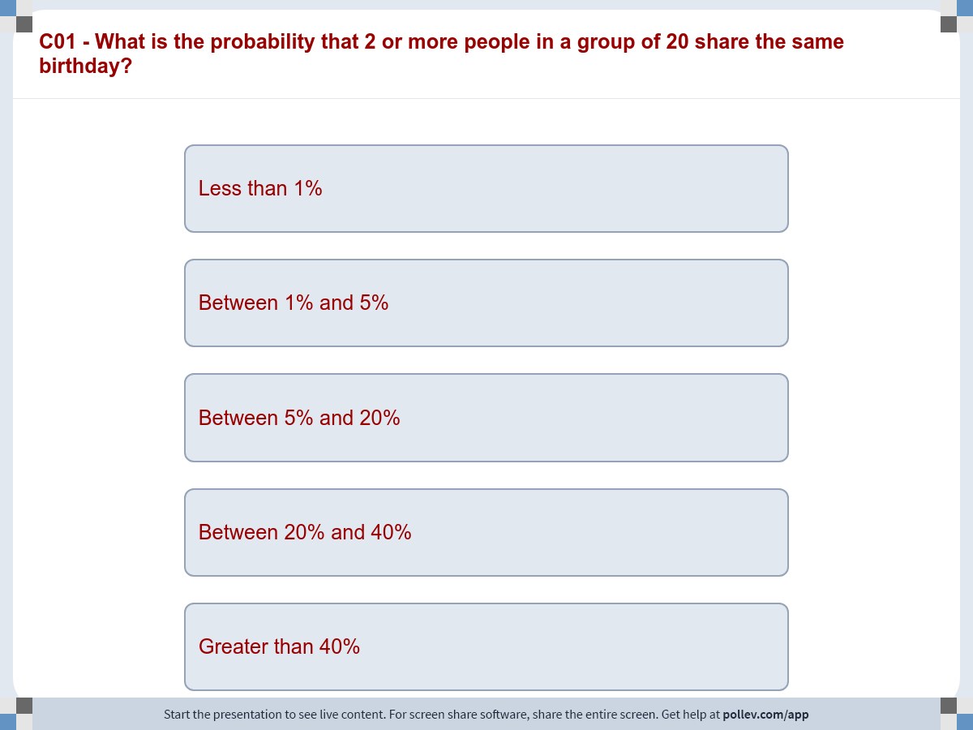
Notes:
Do not modify the notes in this section to avoid tampering with the Poll Everywhere activity.
More info at polleverywhere.com/support
C01 - What is the probability that 2 or more people in a group of 20 share the same birthday?
https://www.polleverywhere.com/multiple_choice_polls/hxq86CTskdTnLH0DVEUU9?display_state=instructions&activity_state=opened&state=opened&flow=Engagement&onscreen=persist

Slide 33
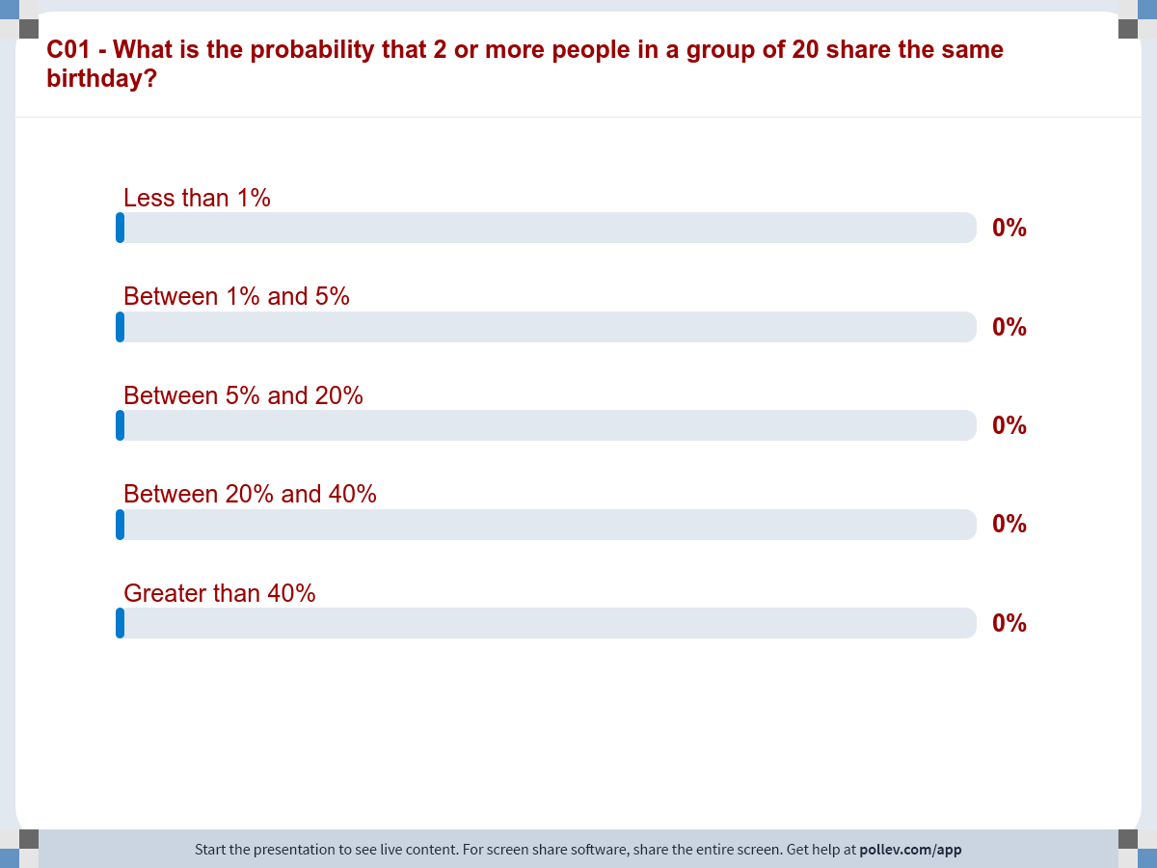
Notes:
Do not modify the notes in this section to avoid tampering with the Poll Everywhere activity.
More info at polleverywhere.com/support
C01 - What is the probability that 2 or more people in a group of 20 share the same birthday?
https://www.polleverywhere.com/multiple_choice_polls/hxq86CTskdTnLH0DVEUU9?display_state=chart&activity_state=closed&state=closed&flow=Engagement&onscreen=persist

Slide 34
API-209
Class #1
Prof. Dan Levy | Harvard Kennedy School | Harvard University

Slide 35
Answer based on probability theory
41%

Slide 36
Got it right!

Slide 37
Got it right!

Slide 38
Did you know about this puzzle?
Yes
No

Slide 39
Answer based on probability theory
≠
Our intuition
Why?

Slide 40
The probability p that at least two people in a group of k people will have the same birthday
k | p
5 | 0.027
10 | 0.117
15 | 0.253
20 | 0.411
22 | 0.476
23 | 0.507
25 | 0.569
30 | 0.706
40 | 0.891
50 | 0.970
60 | 0.994

Slide 41
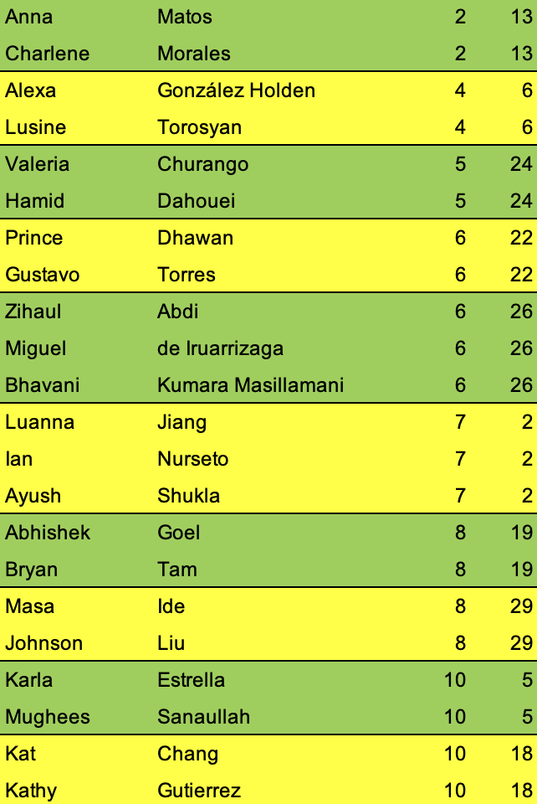
Common birthdays in this class
10 common sets of birthdays!

Slide 42
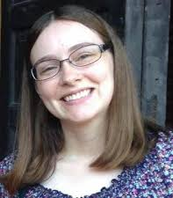
Thank you!
Carol Finney
Sarah Olia
Erin Meade

Slide 43
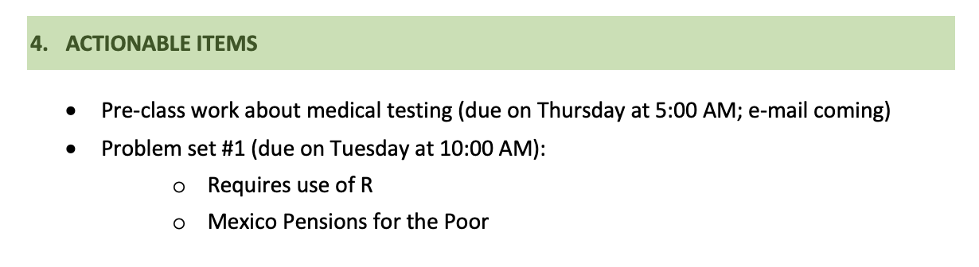
Actionable items

Slide 44
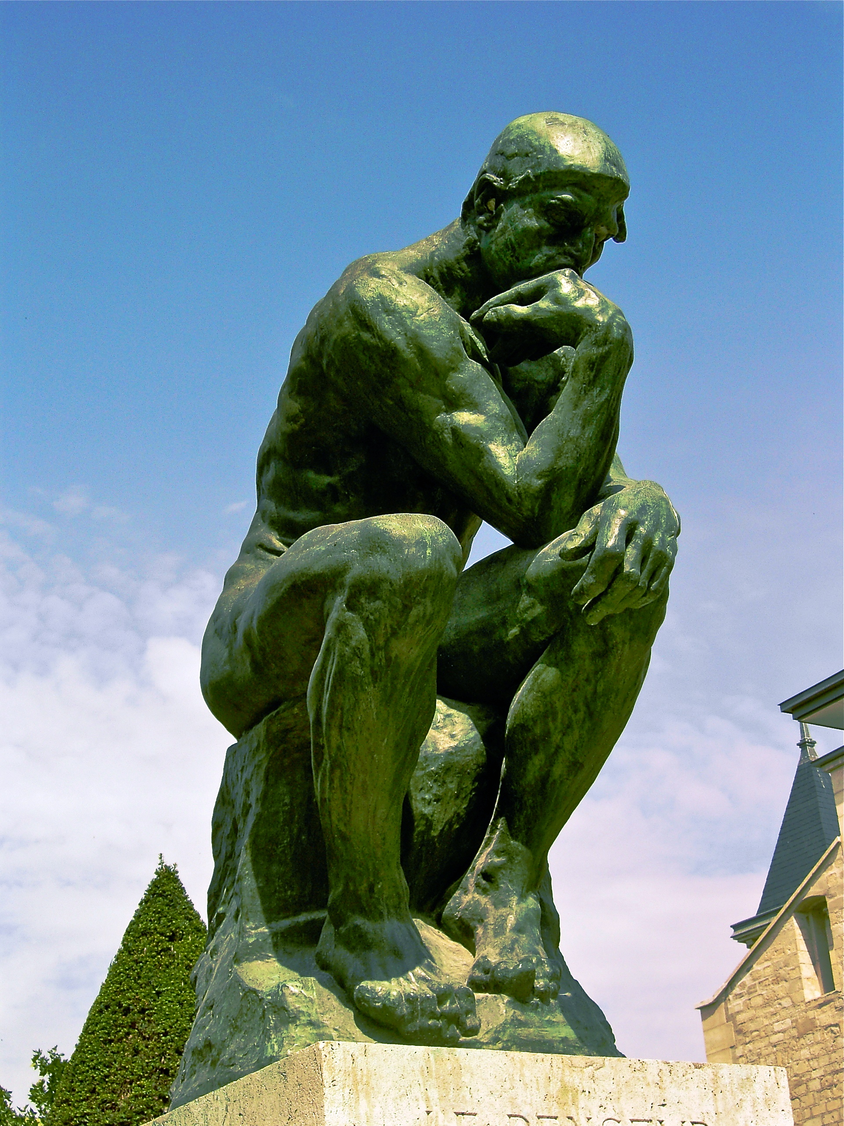
Reflections
Write 1-2 things you want to remember from today’s class using Slack’s #reflection channel..

Slide 45

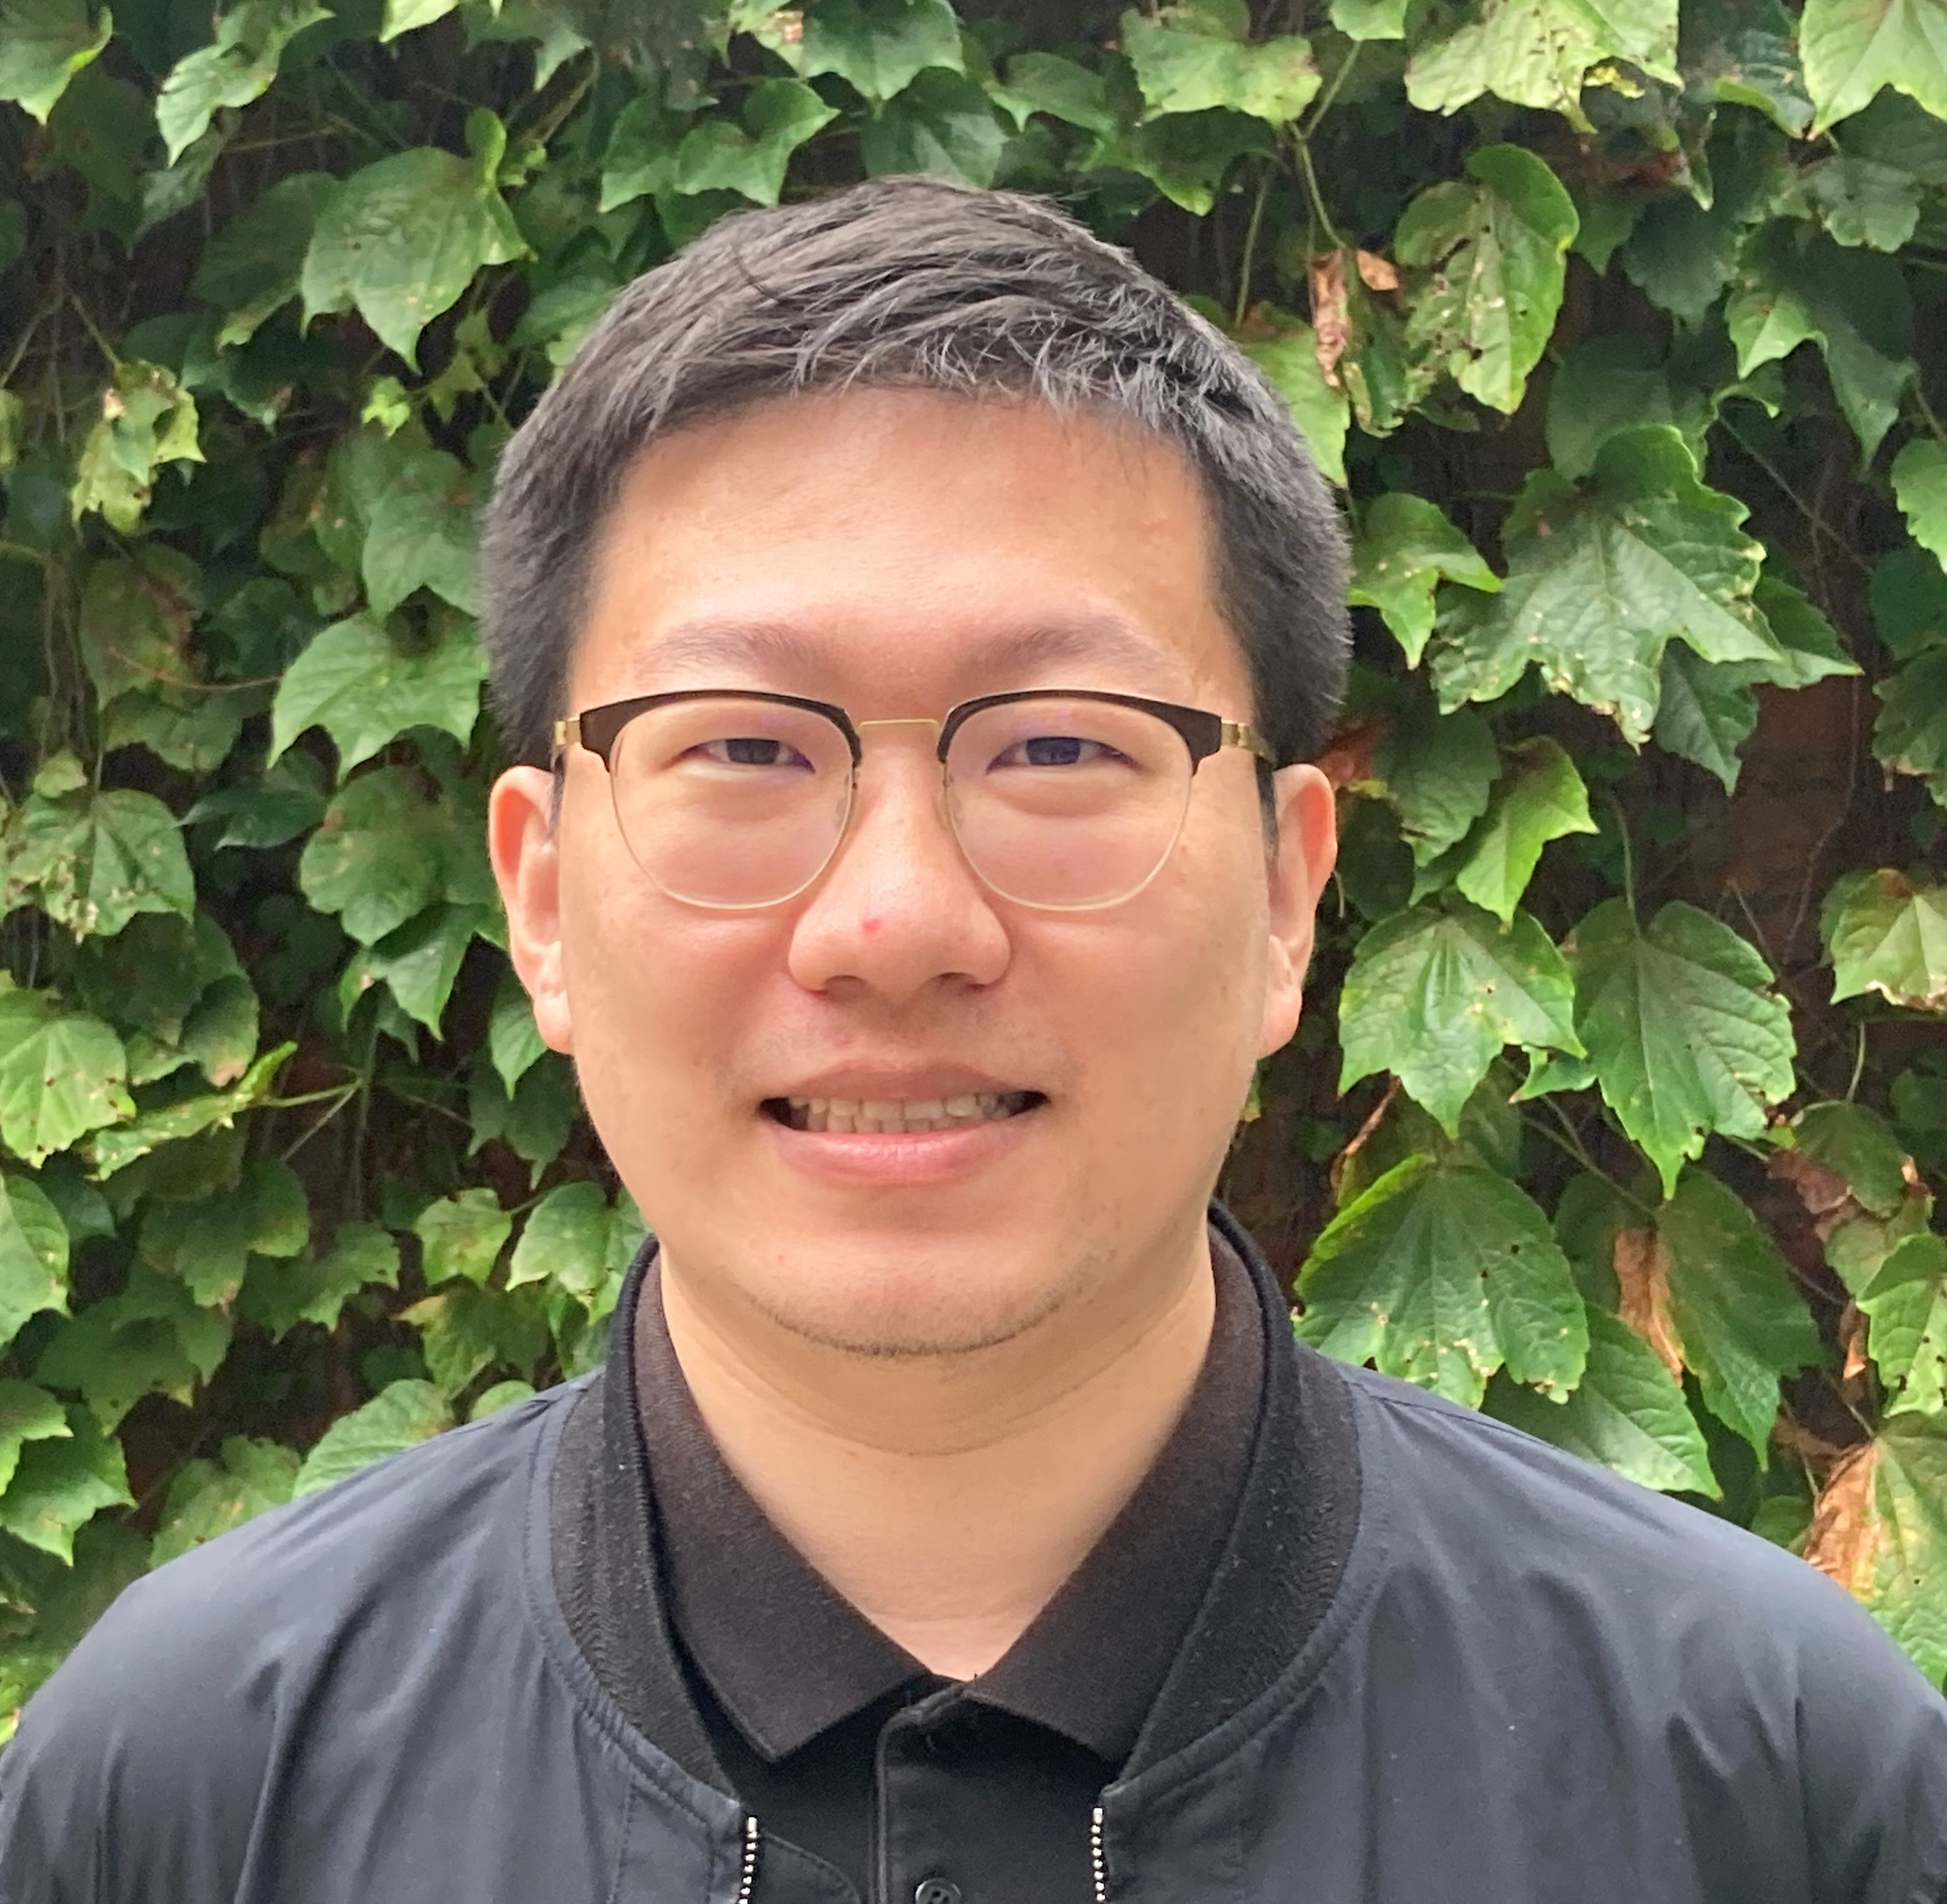
Masa Ide
Johnson Liu

Slide 46
API-209
Class #1
Prof. Dan Levy | Harvard Kennedy School | Harvard University

Slide 47
Back-up slides

Slide 48
Calling List
Seat | Student | Topic
 | Sara Wang Becerra | Descriptive
 | Ishaan Bansal | Causal
 | Alexa González | Predictive
 | Nidhi Rao | Shock Trump

Slide 49
How 538 displayed forecasts in 2020
Source: Fivethirtyeight. Accessed on Aug 31, 2020

Slide 50
How 538 displays forecasts in 2020
Source: Fivethirtyeight. Accessed on Aug 31, 2020

